Slide 1
Analysis of the EU car trade network in recent years
Hannah Schönborn & Máté Hekfusz

Slide 2
Introduction
Intro
Our Network Science project graphs and analyses the EU car trade network in the years of 2019 - 2022.
This not only is the most recent complete data available (thus giving the most up-to-date picture of the trade network) but also includes the years of the Covid-19 crisis as we wanted to see how the pandemic affected the industry.
Data publicly available on Eurostat.
Structure
1. Exploratory data analysis
2. Network visualisation
3. Degree distribution (directed)
4. Edge weight insights of the major players
5. Covid-19 effects on trade values of the biggest exporters
6. Centrality measures
7. Conclusion

Slide 3
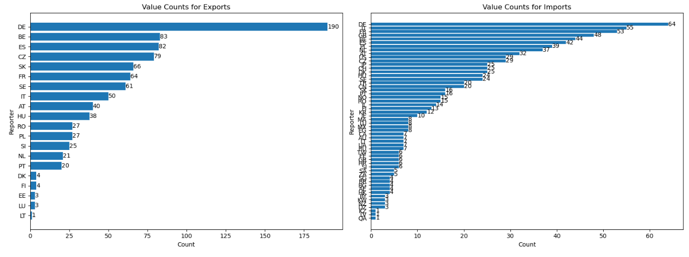
1. Exploratory data analysis

Slide 4
1. Exploratory data analysis
Statistics
Number of nodes: 54
Sum of degrees: 544
Average degree (total): 10.07
Average degree (per year):
2019: 8.98
2020: 8.46
2021: 8.72
2022: 9.15

Slide 5
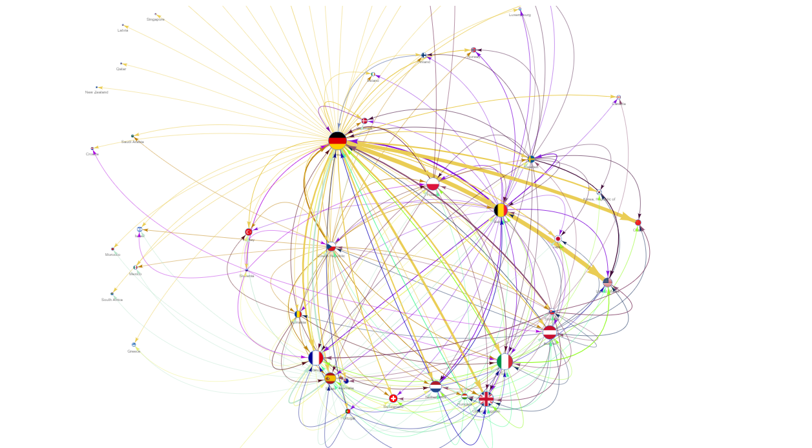
2. Network visualisation

Slide 6
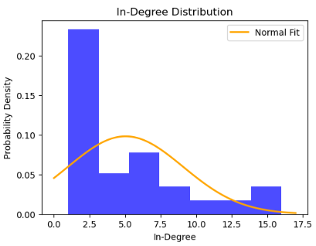
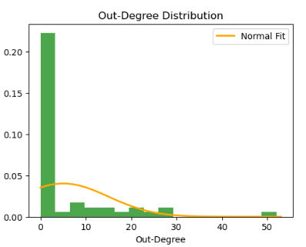
3. Degree distribution
Right-skewed distributions, especially in the out-degree graph.
Interpretations:
Hubs or dominant players
Trade imbalances
Specialisation
Network structure

Slide 7
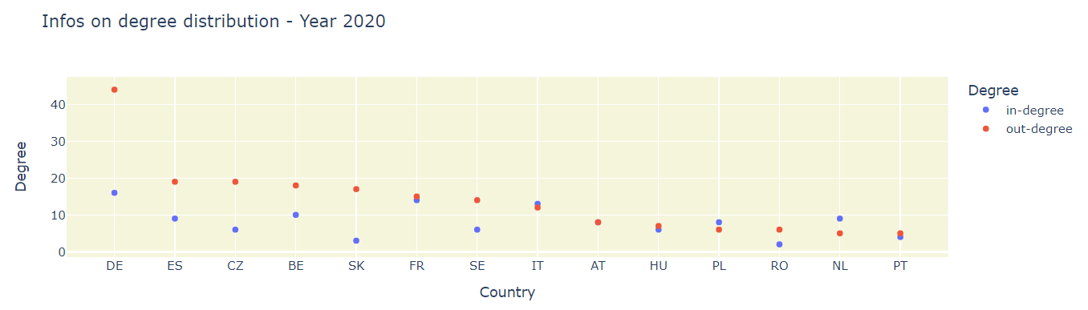
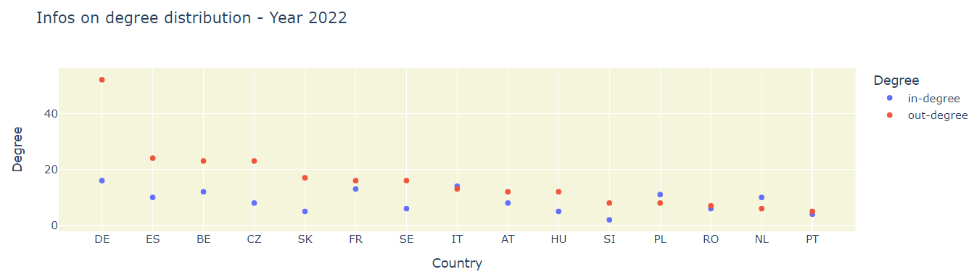
3. Degree distribution

Slide 8
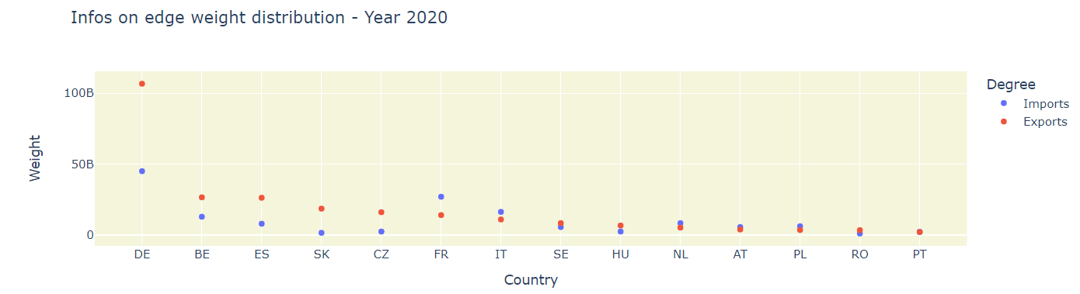
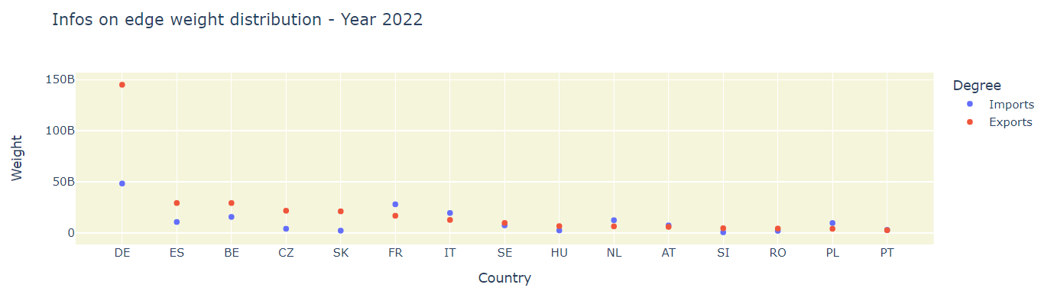
4. Edge weight insights

Slide 9
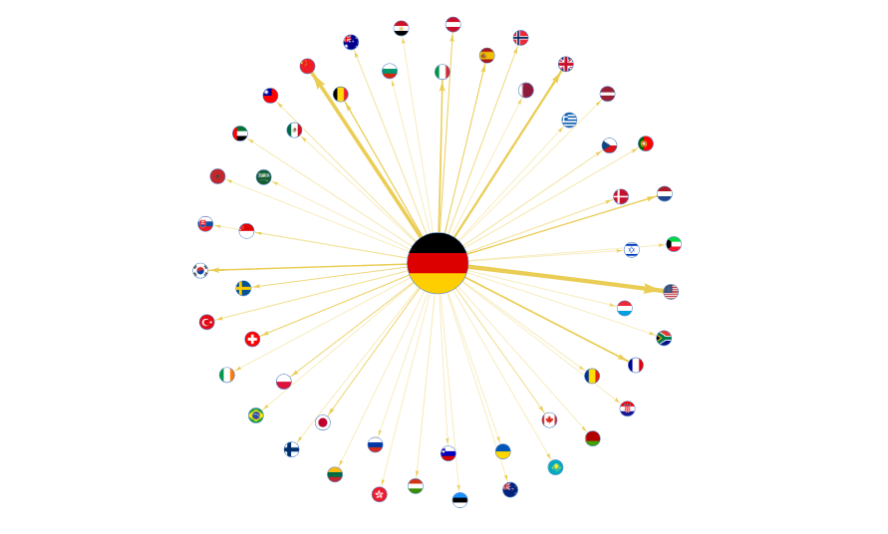
4. Edge weight insights

Slide 10
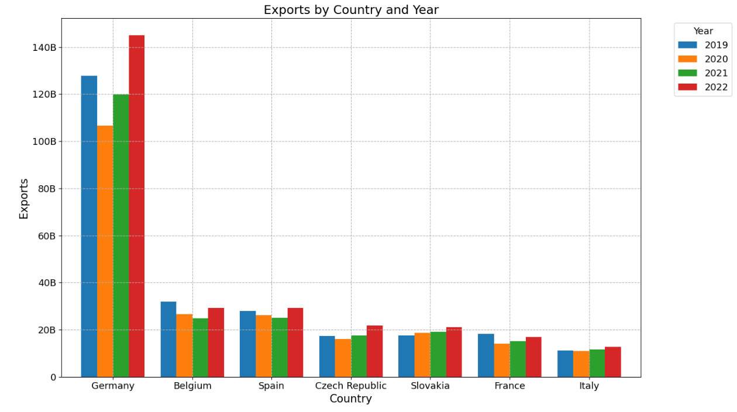
5. Covid-19 effects on trade values

Slide 11
5. Covid-19 effects on trade values
The biggest exporters took a hit during 2020 but quickly recovered.
Potential reasons for this resilience:
Pricing / Inflation
Supply chain adaptability
Government incentives and support
Innovation in technology
Market diversification

Slide 12
6. Centrality measures
Average clustering coefficient: 0.61 (surprisingly high!)
Betweenness Centrality
DE: 0.158
FR: 0.027
BE: 0.022
ES: 0.017
CZ: 0.007
Closeness Centrality
DE: 0.302
GB: 0.277
IT: 0.272
FR: 0.272
BE: 0.247
Eigenvector Centrality
AE: 0.030
AT: 0.192
AU: 0.087
BE: 0.246
BG: 0.030

Slide 13
7. Conclusion
Degree distribution
Right-skewed distributions: small number of countries with significantly higher degrees, acting as "hubs" or dominant players in the network
Interpretations: hubs, imbalances, specialisations, network structure
Change in trade values
Impact of Covid-19: decline but quick recovery
Reasons for resilience: inflation, adaptability, government support, etc.
Relationship between number of partners and trade value
Closely related, though degree is not always a predictor of trade value
Scale-free model
The right-skewed distribution suggests that the EU car trade at high trade values is a scale-free network

Slide 14
Thank you for your attention!

